Slide 1
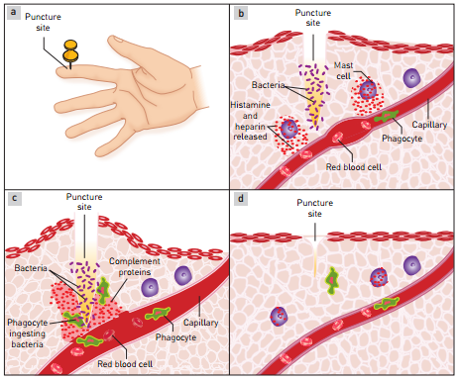
Internal Non-Specific Defences
Phagocytosis, Inflammation, Fever, Lymphatic System
Ch 7 Human Perspectives

Slide 2
Date: | Human Biology Year 12 ATAR
Do Now Get out your stuff, ready to start! Lesson Agenda 1: Do Now 2: Non-Specific Defences 3: Review Worksheet Suggested Study Complete review worksheet, mark and correct using answer key on Connect. Read through today’s notes and textbook section NEXT LESSON Past Exam Question Specific Immunity | Learning Aims Define non-specific defences Discuss the mechanisms of action of the body’s non-specific defences such as: Natural Killer Cells Phagocytosis Inflammation Fever Lymphatic System
 | Key Vocabulary Phagocyte Heparin Inflammation Leukocyte

Slide 3
Internal Non-Specific Defences
Work against any pathogen that enters the body
Not specific to any one pathogen
Broad, generalised reaction to foreign substances or tissue damage.
Natural Killer Cells (NKC)
Phagocytosis
Inflammation
Fever
The Lymphatic System
Learning Aim: Define Non-Specific Defences

Slide 4
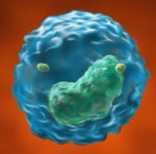
Non- Specific Defences: Natural Killer Cells (NKC)
A type of white blood cell (leucocyte) that kills everything they encounter by releasing chemicals:
Cytokines – alert and attract other immune cells
Other chemicals that destroy cell membranes to kill unhealthy cells.
Why don’t they kill healthy body cells?
Healthy body cells have proteins on their surface that act as “self” markers so they don’t get attacked.
Virus infected cells and cancer cells have fewer of these markers, so are more likely to be killed.
Related to lymphocytes.
Note: there’s another type of lymphocyte
called a killer T-cell that does a similar job and
is related but not identical to NKC
Learning Aim: Describe the role of Natural Killer Cells in non-specific defence against pathogens

Slide 5
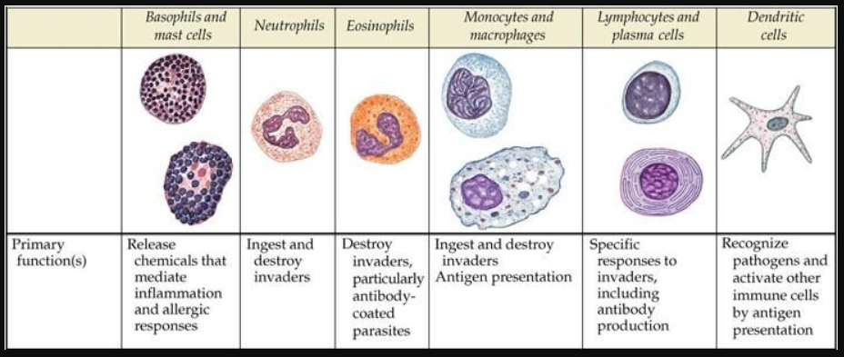
Non-Specific Defences: Phagocytosis
Phagocytes:
Cells that can engulf and digest micro-organisms and cell debris.
Leucocytes (white blood cells – many types – eg Neutrophils, Eosinophils, Monocytes)
In blood stream
Can leave blood and enter tissues at site of injury/disease
Macrophages
Some wander through tissues
Some are fixed
Learning Aim: Describe the role of Phagocytes in non-specific defence against pathogens

Slide 6
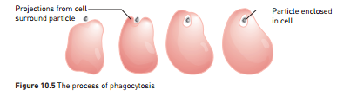
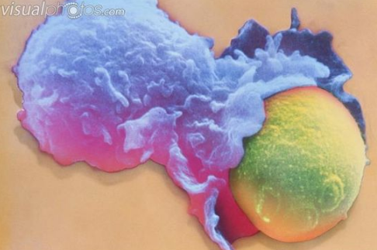

Slide 7
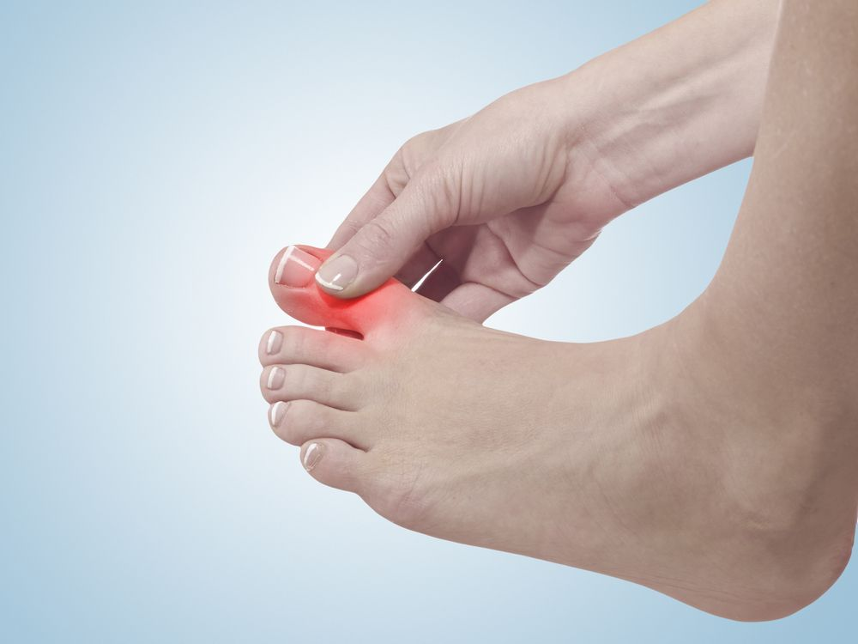
Non-Specific Defences: Inflammation
Response to any tissue damage
Reduces spread of pathogens
Removes damaged tissue and cell debris
Begins repair of damaged tissue
Suffix –itis refers to inflammation
Tonsillitis, laryngitis, meningitis etc
Four signs of inflammation
Redness
Heat
Swelling
Pain
Learning Aim: Describe the role and mechanism of action of inflammation in non-specific defence against pathogens

Slide 8
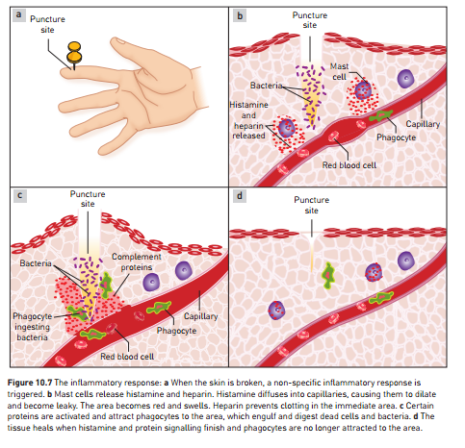
Steps in the Process of Inflammation
a: Tissue damage occurs.
Pathogens may or may not be introduced to continue damage.
b: Tissue Damage causes Mast cells release
histamine and heparin.
Histamine causes local capillaries to dilate and become leaky, allowing phagocytes and other leukocytes to enter the area.
This causes heat, redness and swelling and pain.
Heparin prevents clotting in the immediate area.
c: Complement proteins are activated, and
attract phagocytes.
They are able to enter the area of damage due to the leaky, dilated capillaries from step b.
Phagocytes engulf and digest dead cells and bacteria.
Fun Fact: pus is made from dead and dying cells and bacteria!
d: Once pathogens are cleared, mast cells and
complement stop messaging
Local capillaries return to normal
Phagocytosis ceases
Stage is set for tissue healing.
Learning Aim: Describe the role and mechanism of action of inflammation in non-specific defence against pathogens

Slide 9
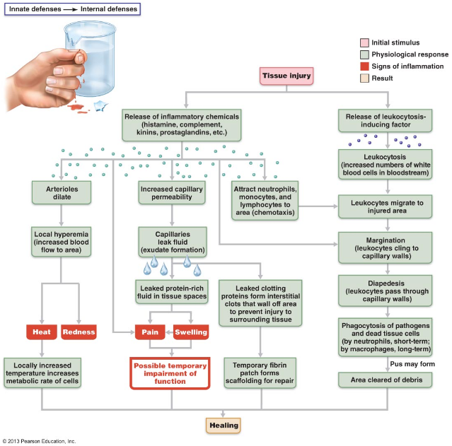
A more complex diagram of the events of inflammation after tissue injury. You DO NOT need to know this information in this detail. It’s just for additional perspective.

Slide 10
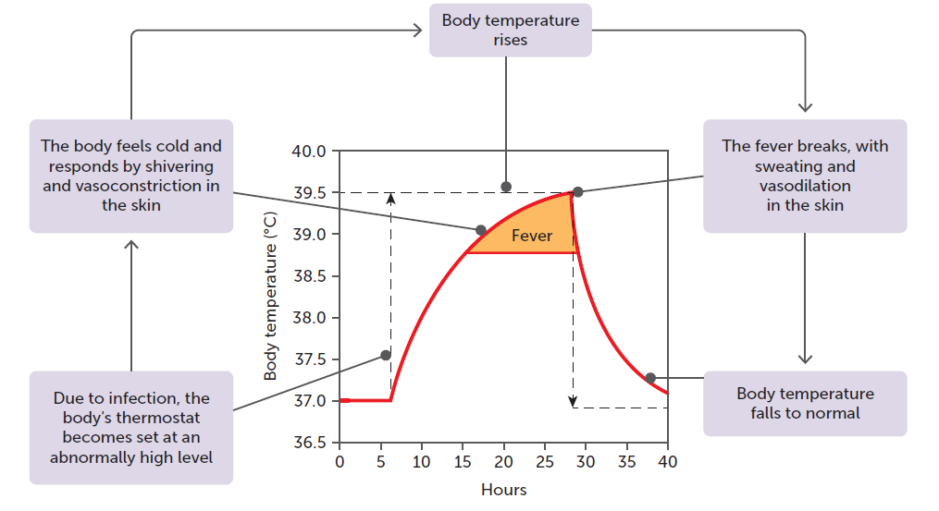
Non-Specific Defences: Fever (Pyrexia)
Part of the body’s natural immune response to infection.
Body raises temperature to combat pathogens such as viruses or bacteria.
After encountering infection, white blood cells release pyrogens (fever causing chemicals) eg: interleukin-1
Pyrogens affect the hypothalamus so that the normal set point of 37ºC is temporarily reset to a higher temperature.
Hypothalamus then initiates warming responses to raise body temperature to the new, temporary set point.
These include normal warming responses such as shivering, vasoconstriction, seeking warmth etc, until the body temperature reaches the new “set point”.
Once the infection has been dealt with, the immune system stops producing pyrogens, and the “set point” returns to normal.
The person then feels hot and cooling responses are activated eg sweating and vasodilation.
Fever is beneficial, but only up to a point. Prolonged, high fever can cause harm and even death, if the immune system is unable deal with the infection quickly and effectively.
Learning Aim: Discuss why fever occurs and the physiological processes involved.

Slide 11
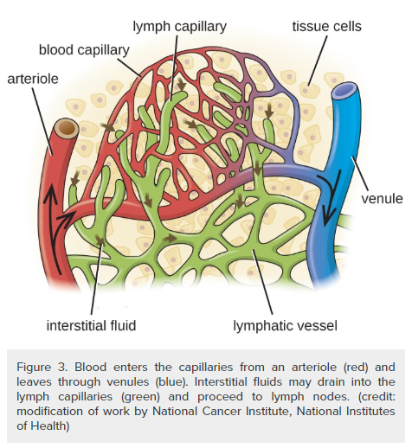
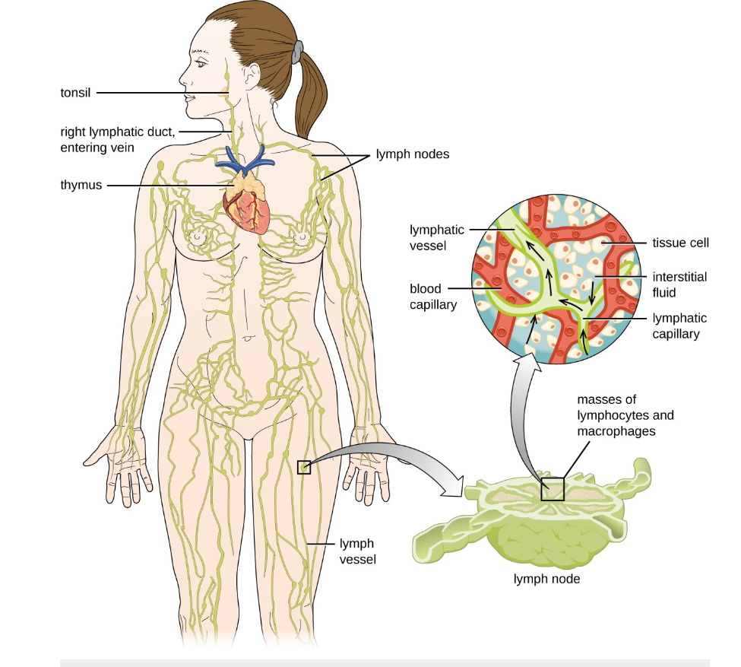
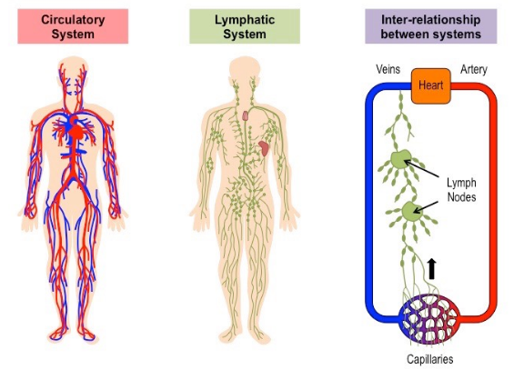
Non-Specific Defences: The Lymphatic System
Network of vessels
Collects fluid in intracellular space, that has escaped capillaries
Moves it through a series of vessels (no pump – uses squeezing of skeletal muscles during body movement)
lymph nodes filter lymph and trap pathogens
Returns it to blood circulation
Learning Aim: Describe the role and mechanism of action of the lymphatic system in non-specific defence against pathogens

Slide 12
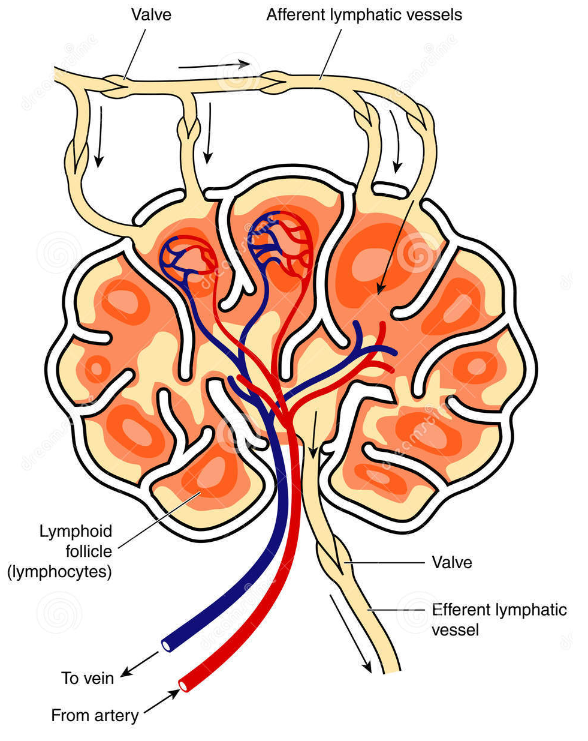
Non-Specific Defences: The Lymphatic System – Lymph Nodes
Lymph nodes
Filter lymph
Process cell debris, foreign particles, microorganisms
Contain lymphoid follicles that contain WBC – esp lymphocytes and macrophages)
Crisscrossed by fibres to trap particles
Can become swollen and inflamed during infection
Lymphocytes are also important in specific immunity
Learning Aim: Describe the role of lymph nodes in non-specific defence against pathogens

